Slide 1
Movie Prediction Rating System
Janani Sankarasubramanian
Ronak Sankaranarayanan
Siddhi Patil
Sitanshu Nithin Rupani

Slide 2
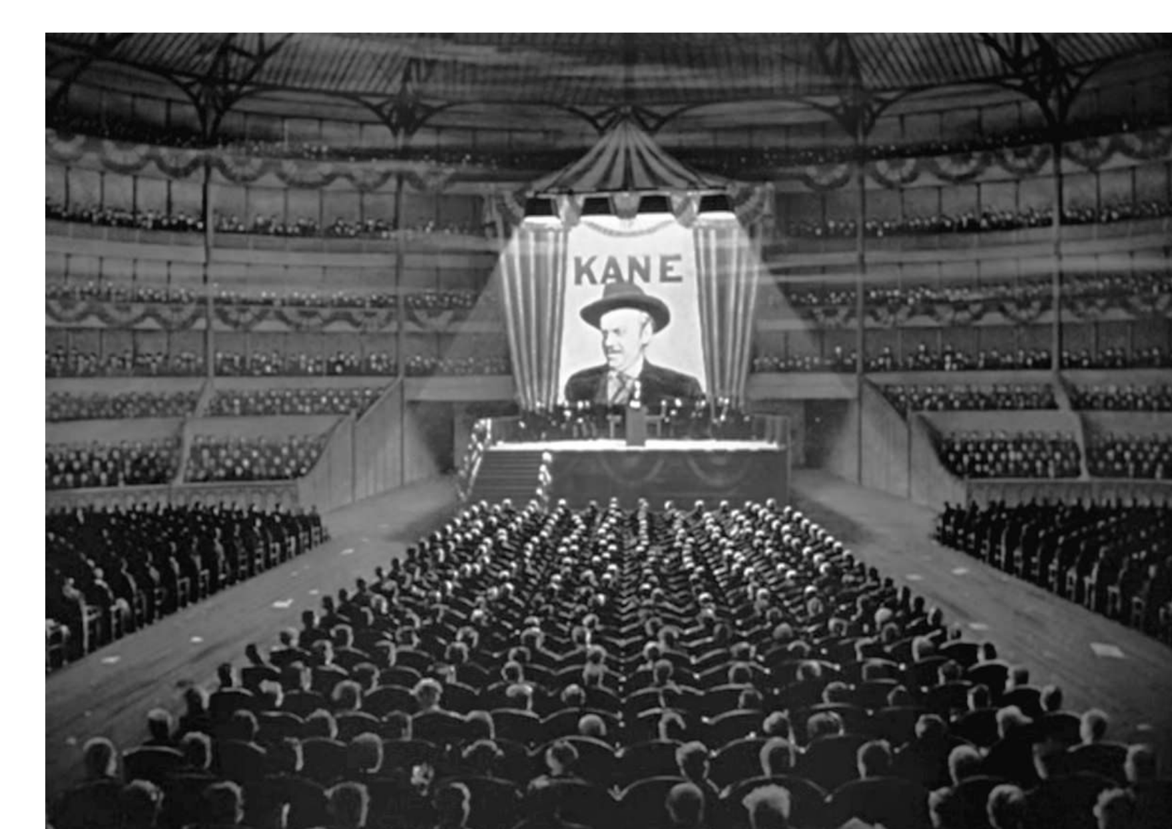
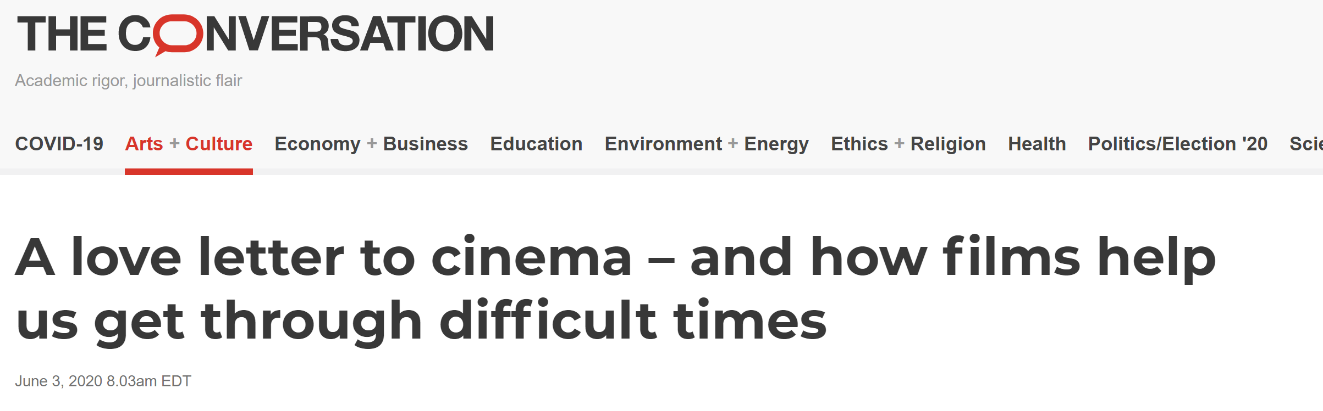
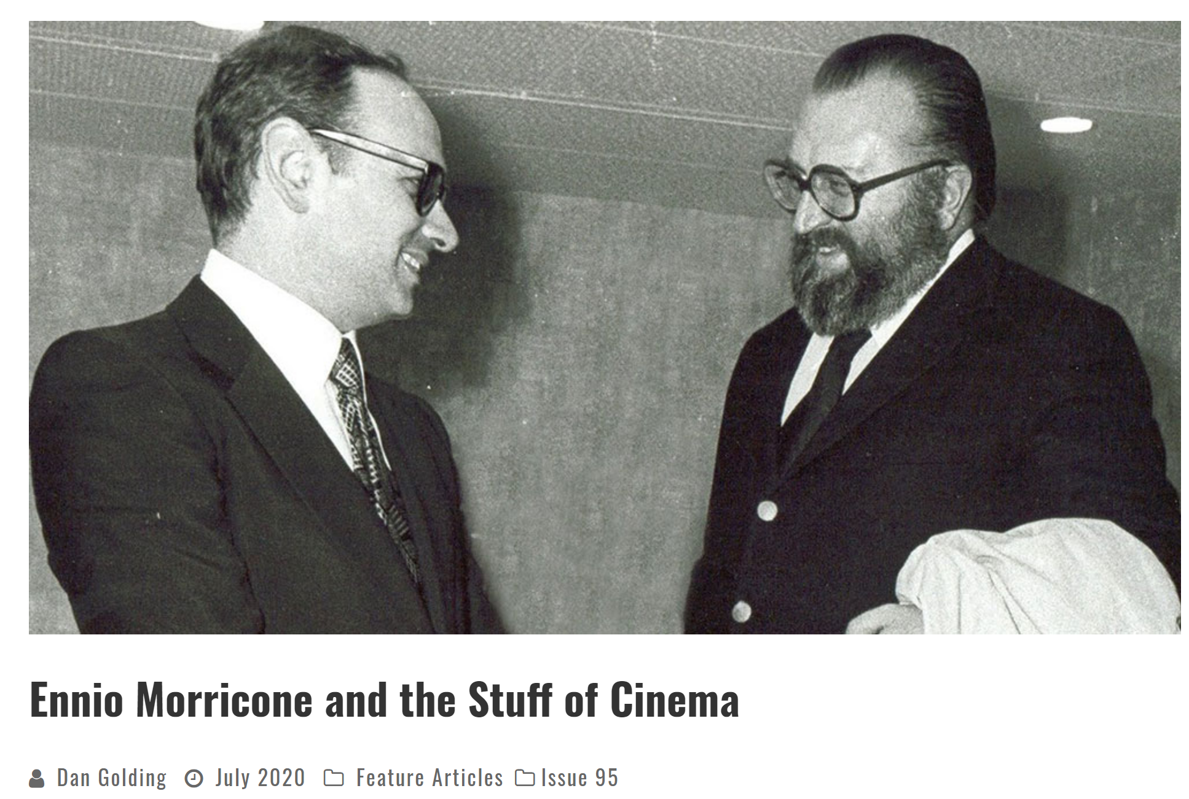

Slide 3
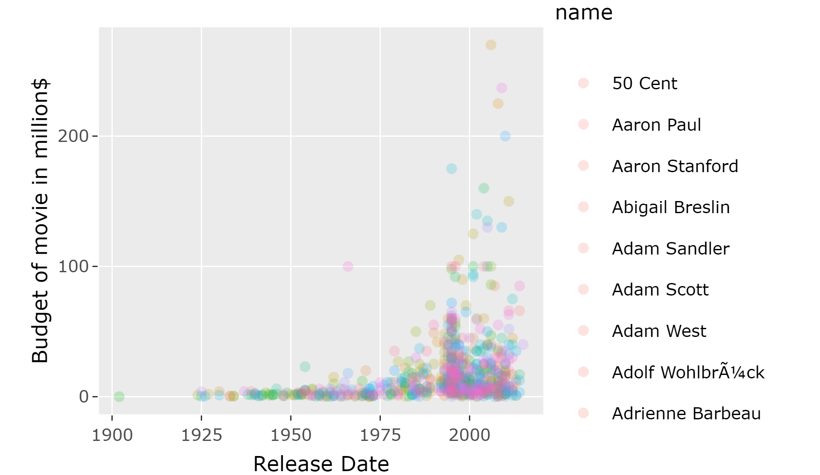

Slide 4
Summary of Dataset
Dataset from : kaggle.com/the-movies-dataset
45000 movies
270000 unique ratings
20 unique genres
36000 casts
42000 crew

Slide 5
Data Cleaning (Stringified JSON objects)
Genres
Keywords
Production Companies
Production Countries
Spoken Language
Cast Data
Crew Data

Slide 6
Pre processing :
Feature Extraction
Merge
Feature Engineering
Initially JSON strings, fromJSON from jsonline.
Later, Regex (Regular Expression)
merge() was used to join data in two different join types
Handling Null values, dropping unwanted data columns, data conversion

Slide 7
Movie Meta data:
JSON String
Genres
production company production country language.
Other features
Budget
Revenue
belongs to collection homepage
imdb id
run time etc.

Slide 8
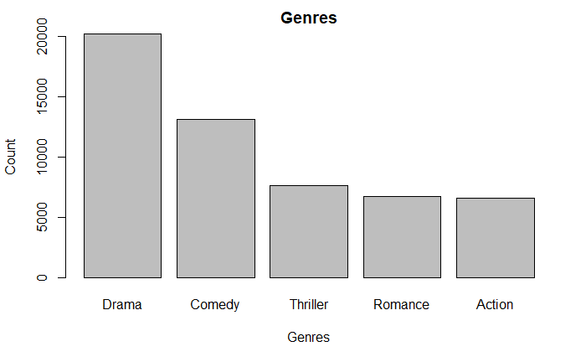
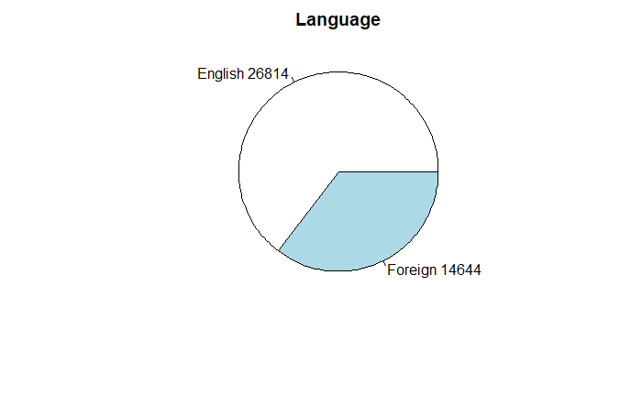

Slide 9
Keywords
Primary key: movie ID
JSON Stringified : Keywords
Frequency more than 50
One hot encoding has been performed.

Slide 10
Ratings
Features : Movie id, userid, timestamp and rating
Aggregate() on movie_id to get mean rating of each movie.
The user_id and Timestamp data has been dropped

Slide 11
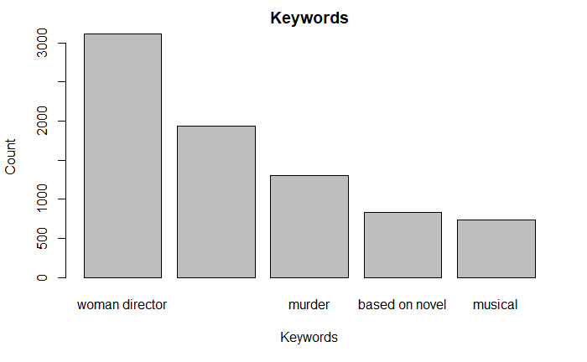
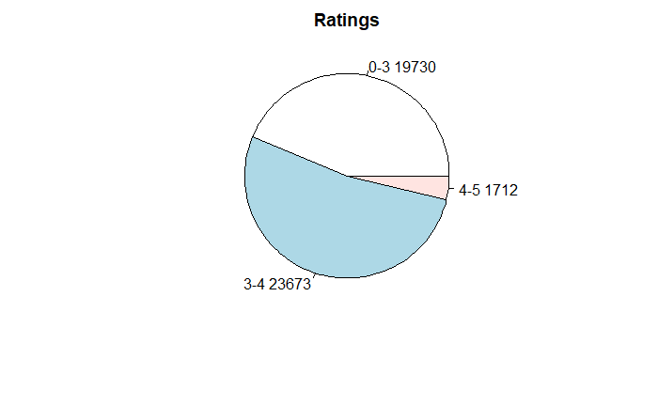

Slide 12
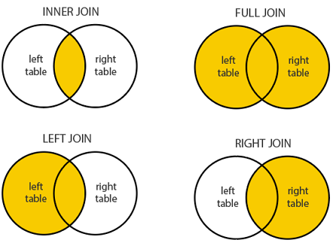
Merging the Data
Genres, production company, production country, language and keywords – Left Join with movie dataset
Ratings – Inner join with Movie dataset
https://www.dofactory.com/sql/join

Slide 13
Feature Engineering.
Dropping unwanted Columns.
Null Values
PCA
Data Conversion

Slide 14
Hierarchical Cross Validation
80% - 20% : Sample Data - Vault data
Vault data has been saved as a csv and open only on the project day
The Sample data has been split again
80% 20% : Training Data- Testing data.
Each of the following model has been trained and cross validated.

Slide 15
Imbalanced Dataset
Very few movies with ratings > 4
SMOTE – oversampling technique
Before SMOTE After SMOTE
 | L (0-3) | A (3-4) | U (4-5)
Count | 2057 | 3375 | 168
 | L (0-3) | A (3-4) | U (4-5)
Count | 2057 | 3375 | 1848

Slide 16

Quadratic Discriminant Analysis
Classes have different Gaussians
Flexible approach
Nonlinear decision boundary
Mathematically,

Slide 17
QDA Models – Test Data Results
Trained on SMOTE Data
Prediction | Original
 | L | A | U
L | 209 | 323 | 6
A | 184 | 377 | 10
U | 94 | 187 | 10
 | L | A | U
F1 score | 0.40 | 0.52 | 0.06

Slide 18
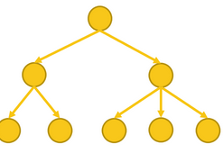
Decision Trees
Highly interpretable
Repeatedly divides feature space into two subsets
Pruning a tree to avoid overfitting
Criteria used –
Gini Index
Information Gain

Slide 19
Decision Trees
10-fold cross validation to construct an optimal tree using caret package
Vote count, Popularity and runtime as important predictors
Overall Test Accuracy : 0.64

Slide 20
Decision Tree – Test Data Results
Trained on SMOTE Data
Prediction | Original
 | L | A | U
L | 46 | 52 | 1
A | 436 | 824 | 22
U | 5 | 11 | 3
 | L | A | U
F1 score | 0.15 | 0.75 | 0.13

Slide 21
Accuracy of QDA and Decision Tree across different Genres
QDA
Comedy + Romance : 0.58
Thriller + Mystery : 0.59
Decision Tree
Drama : 0.66
Comedy + Romance : 0.64

Slide 22
KNN Classifier
Predictions made based on distance in Euclidian Space
Classification is carried out by ‘voting’ of K nearest values
K value chosen using Cross validation
Suffers from the curse of dimensionality

Slide 23
KNN Classifier – Test Data Results
Trained on Oversampled Data
Prediction | Original
 | L | A | U
L | 192 | 231 | 7
A | 265 | 588 | 14
U | 30 | 68 | 5
 | L | A | U
F1 score | 0.42 | 0.67 | 0.08
Model Accuracy: 56.07%
Optimal value for k was chosen to be 5, using 10 fold cross validation

Slide 24
Random Forests
Ensemble learning technique
Uses bagging
Helps reduce variance by aggregating multiple weak learners

Slide 25
Random Forest – Test Data Results
Trained on Oversampled Data
Prediction | Original
 | L | A | U
L | 170 | 116 | 4
A | 317 | 771 | 18
U | 0 | 0 | 4
 | L | A | U
F1 score | 0.44 | 0.77 | 0.26
Model Accuracy: 67.5%

Slide 26
How KNN Classifier and Random Forests across some striated Genres and Subgenres
KNN Classifier
Drama-Comedy, Action-Adventure, Crime-Thriller films perform better than the overall model
Family-Comedy, Thriller-SciFi are worse off than the overall model
Random Forest
Drama-Comedy, Crime-Thriller films perform better than the overall model
Action-Adventure, SciFi-Horror are worse off than the overall model

Slide 27
The Vault
Algorithm | Accuracy
Decision Trees | 61.02%
QDA | 38.91%
KNN | 57.4%
Random Forest | 67.02%

Slide 28
Thanks!
Any questions?

